Slide 1
COLOR CLASSIFICATION
​

Slide 2
AGENDA
Why
How we can see apple
split
Model 1
Model 2
evaluate the data
​Summary​

Slide 3
why
COLORS ARE A FUNDAMENTAL ASPECT OF OUR VISUAL PERCEPTION, AND PLAY AN ESSENTIAL ROLE IN OUR DAILY LIVES. APPLICATIONS IN AREAS SUCH AS IMAGE RECOGNITION, COLORBASED SEARCH, AND COLOR-BASED RECOMMENDATIONS. FURTHERMORE.

Slide 4
How can we teach a computer to recognize the colors of fruits?

Slide 5

Take an apple, for example. Computers don't have eyes to see like humans do, and the only language that computers understand is binary code made up of 0s and 1s. Therefore, we need to represent the image of the apple in a way that a computer can recognize. This process involves translating the image into a format that the computer can interpret.

Slide 6
For machine learning, colors can be represented as numerical values using a variety of methods. Here are a few common ways that color can be represented for machine learning:
1.RGB values
2.Hexadecimal codes
3.HSL values

Slide 7
RGp

Slide 8



RGB stands for red, green, and blue, which are the primary colors of light. In computing, RGB values are used to represent colors as numerical values. In the RGB color model, colors are represented as a combination of red, green, and blue values, with each value ranging from 0 to 255.
System
In an RGB color value, the first number represents the intensity of red, the second number represents the intensity of green, and the third number represents the intensity of blue. For example, the RGB value for the color red is (255, 0, 0), which means that the intensity of red is at its maximum (255), and the intensities of green and blue are at their minimum (0).
How ?
there are 256 possible values for each primary color (0-255), and thus a total of 256 * 256 * 256 = 16,777,216 possible colors that can be represented using RGB values.
Palette

Slide 9


Advantage
Disadvantage
Commonly used: RGB is a widely used color model in computer graphics, digital photography, and other applications, which means that it is well-supported and easy to work with.
Easy to understand: The concept of combining red, green, and blue to create colors is relatively easy to understand, even for non-experts.
Limited color gamut: The RGB color model is not able to represent all colors that are visible to the human eye, which can lead to color inaccuracies in some situations.
Device-dependent: The same RGB values may appear different on different devices or displays, which can lead to inconsistencies in color representation.

Slide 10
split

Slide 11
why we need to split the data?
Preventing overfitting: By splitting the data into separate sets for training and testing, we can ensure that the model is not simply memorizing the training data and is instead learning more generalizable patterns. If we only test the model on the same data that it was trained on, it may perform well on that data but poorly on new, unseen data.
Evaluating model performance: By splitting the data into separate sets for training, validation, and testing, we can evaluate the performance of the model on different datasets. The training set is used to train the model, the validation set is used to tune the model's hyperparameters and evaluate its performance during training, and the testing set is used to evaluate the final performance of the model on new, unseen data.
Improving generalization: By using different datasets for training, validation, and testing, we can ensure that the model is learning patterns that are generalizable to new data, rather than simply memorizing the training data.

Slide 12
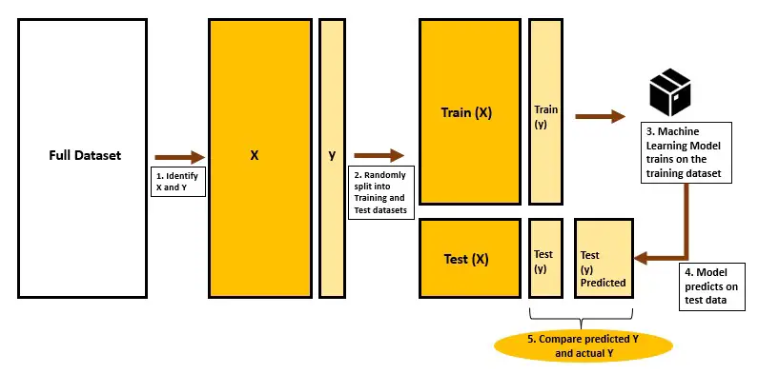

Slide 13
Model 1

Slide 14

Logistic regression
Logistic regression is a popular statistical method for binary classification tasks, where the goal is to predict the probability of an event occurring based on a set of predictor variables.
In logistic regression, the output variable is a binary variable that takes on one of two possible values (e.g., 0 or 1), and the input variables can be either continuous or categorical.
The logistic regression model works by fitting a logistic function to the input data, which maps the input variables to a probability value between 0 and 1.
This probability value represents the likelihood that the output variable will take on the value 1, given the input variables. The logistic function is typically represented as a sigmoid curve, which starts at 0 and gradually approaches 1 as the input variables increase.

Slide 15
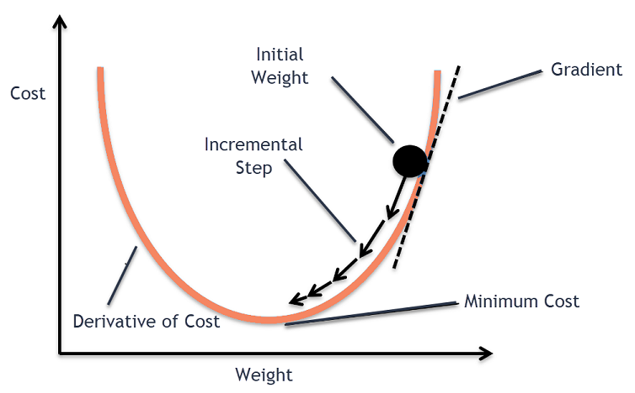
gradient descent
The logistic regression model can be trained using various optimization algorithms, such as gradient descent, that minimize the difference between the predicted probabilities and the actual binary values of the output variable in the training data. Once the model is trained, it can be used to make predictions on new data by applying the logistic function to the input variables and comparing the resulting probability value to a threshold value (e.g., 0.5) to determine the predicted binary value of the output variable.

Slide 16
Model 2

Slide 17

neural network model
1. The code first creates an instance of a Sequential model, which is a linear stack of layers that can be used to build a neural network.
2. The code then adds two fully connected layers to the model using the Dense class, with the first layer having 64 neurons and a ReLU activation function, and the second layer having a number of neurons equal to the number of unique classes in the target variable and a softmax activation function.
3. The code then compiles the model using categorical cross-entropy loss, Adam optimizer, and accuracy metric.

Slide 18
neural network model
4.The code trains the model on the training data for 50 epochs with a batch size of 32, and uses validation data to monitor performance during training.
5..The code evaluates the performance of the model on the test data using the evaluate() method, which returns the loss and accuracy of the model on the test data.
6.Finally, the code prints out the test accuracy of the model as a percentage.

Slide 19
VS

Slide 20
Advantage
Simplicity and interpretability: Logistic regression is a relatively simple and easy-to-understand model that can be interpreted using coefficient values. This can make it a good choice for tasks where interpretability is important.
Low complexity: Logistic regression is a low-complexity model that requires relatively little computation and storage, making it well-suited for tasks with limited computing resources.
Good for linearly separable data: Logistic regression can perform well on linearly separable data, and can handle binary and multi-class classification tasks.
High expressiveness: Neural networks can capture complex non-linear relationships between the input variables and the output variable, making them well-suited for tasks with non-linear data.
High flexibility: Neural networks can be designed with a wide range of architectures and hyperparameters, making them well-suited for a wide range of tasks.
High accuracy: Neural networks can achieve state-of-the-art accuracy on many complex tasks, such as image recognition and natural language processing.

Slide 21
Disadvantage
Limited expressiveness: Logistic regression is a linear model that may not be able to capture complex non-linear relationships between the input variables and the outcome variable.
Limited flexibility: Logistic regression assumes a fixed functional form between the input variables and the output variable, which may not be appropriate for all tasks.
May not perform well on imbalanced data: Logistic regression may not perform well on imbalanced datasets, where one class has significantly more samples than the other.
Complexity and black-box nature: Neural networks can be complex and difficult to understand, and may require significant computation and storage resources to train and run. They are often described as "black boxes" because it can be difficult to understand how they arrive at their predictions.
Susceptibility to overfitting: Neural networks can be prone to overfitting on small datasets, where the model memorizes the training data rather than learning generalizable patterns.
Require a large amount of data: Neural networks typically require a large amount of data to train effectively, which may not be available for some tasks.

Slide 22
evaluate the data

Slide 23
AGENDA
accuracy
precision scores
recall score
confusion matrix

Slide 24


accuracy
orange
apple
Accuracy=(correct classified/total data) = 7/10
So accuracy of this module is 70%

Slide 25
Problem with accuracy
If I have unbalanced data
For exam:
If I have 990 orange and 10 apple
(The accuracy 99% because every thing is orange)

Slide 26
precision scores for apple class
orange
apple
precision=(total apple correct/total data in apple class) = 3/5
So precision of this module is 60%

Slide 27
Recall for apple class
orange
apple
recall=(total apple correct/total apples) = 3/4
So recall of this module is 75%

Slide 28
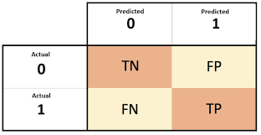
confusion matrix
orange
apple
Confusion matrix

Slide 29
SUMMARY
this presentation provided an overview of the key concepts and techniques in machine learning, as well as some practical tips for building and deploying effective machine learning models.

Slide 30
End. Now to the code

Slide 31

COLOR
CLASSIFICATION

Slide 32
WHY?
COLORS ARE A FUNDAMENTAL ASPECT OF OUR VISUAL PERCEPTION, AND PLAY AN ESSENTIAL ROLE IN OUR DAILY LIVES. APPLICATIONS IN
AREAS SUCH AS IMAGE RECOGNITION, COLOR- BASED SEARCH, AND COLOR- BASED
RECOMMENDATIONS. FURTHERMORE.

Slide 33
MAIN PROBLEM FACED
THE TRAINING DATA WE INITAILY USED WAS NOT CLEAN AT ALL.
IT HAD LOTS OF INCONSISTENCIES, AND WAS DESTINED TO OUTCOME A BIASED OUTPUT.

Slide 34
SOLUTION?
IF YOU CANT FIX IT..... JUST THROW IT AWAY!!
WE CHANGED ALL OF THE DATASET INTO A NEW CLEAN ONE
DATASET

Slide 35
DATA PROCESSING:
WE START BY LOADING THE DATASET FROM A DIRECTORY USING THE OS LIBRARY.
WE ITERATE OVER EVERY DIRECTORY IN THE DATASET, EACH OF WHICH CORRESPONDS TO A DIFFERENT COLOR.
FOR EACH IMAGE IN THE DIRECTORY, WE USE THE COLORTHIEF LIBRARY TO EXTRACT ITS DOMINANT COLOR IN R, G , B VALUES ( 0 - 255 ) AND STORE IT
ALONG WITH THE IMAGE' S LABEL ( I . E., THE COLOR DIRECTORY) IN A PANDAS DATAFRAME.
WE THEN SPLIT THE DATA INTO TRAINING AND TESTING SETS AND PREPROCESS IT BY ONE- HOT ENCODING THE LABELS.

Slide 36
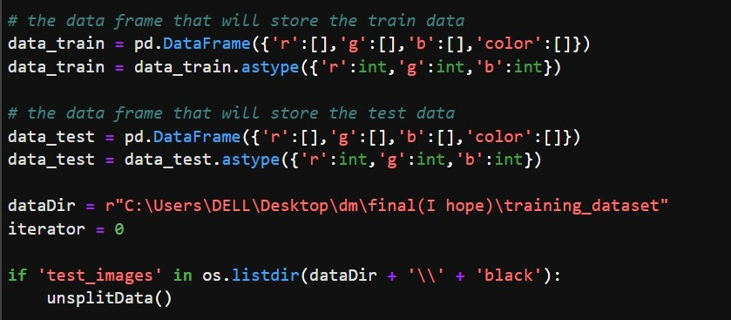

Slide 37
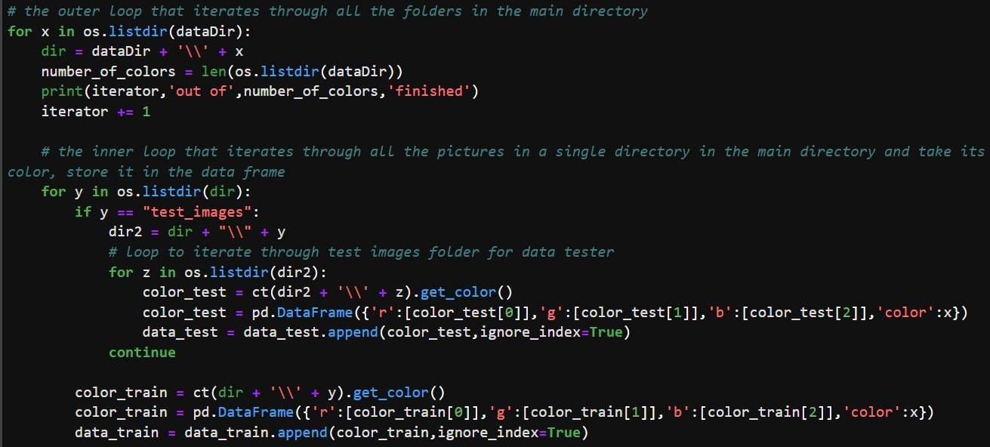

Slide 38
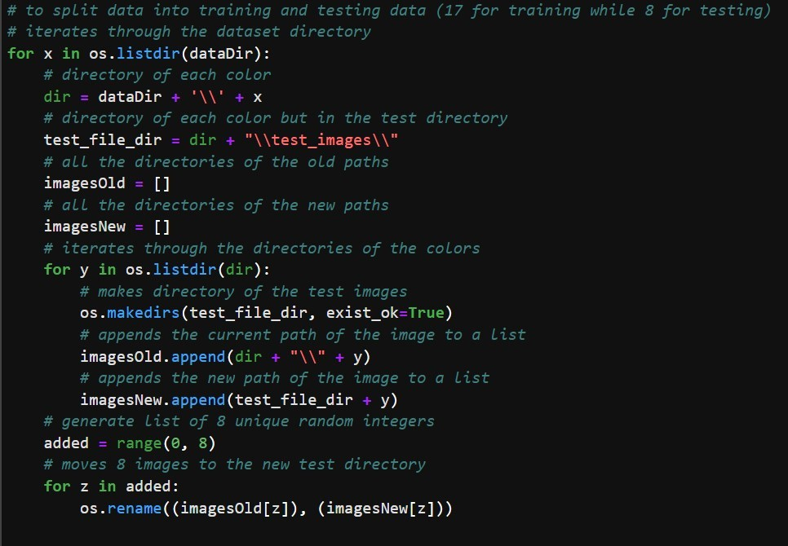

Slide 39
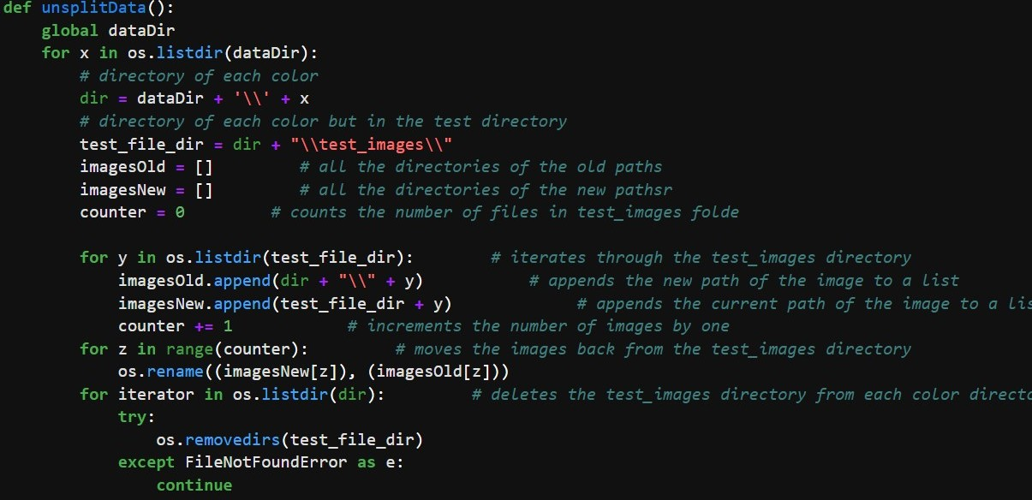

Slide 40
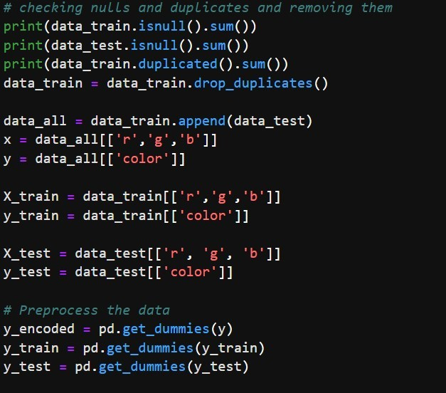

Slide 41
NEURAL NETWORK MODEL
NEXT, WE TRAIN NEURAL NETWORK MODEL ON THE DATA USING KERAS' SEQUENTIAL CLASS.
THE ANN MODEL CONSISTS OF TWO FULLY CONNECTED LAYERS WITH RELU AND SOFTMAX ACTIVATION FUNCTIONS, RESPECTIVELY.
WE TRAIN THE MODEL ON THE TRAINING SET FOR 50 EPOCHS WITH A BATCH SIZE OF 32 AND USE VALIDATION DATA TO MONITOR PERFORMANCE.
WE EVALUATE THE MODEL' S PERFORMANCE ON THE TEST SET USING ACCURACY, PRECISION, RECALL, AND A CLASSIFICATION REPORT.
THE ANN MODEL ACHIEVES HIGH ACCURACY, PRECISION, AND RECALL SCORES ON THE TEST SET, OUTPERFORMING THE LOGISTIC REGRESSION MODEL.

Slide 42
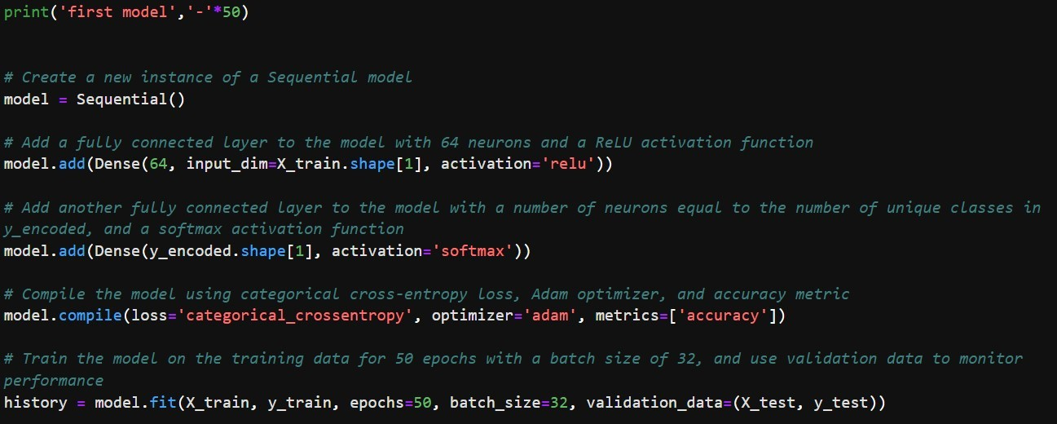

Slide 43
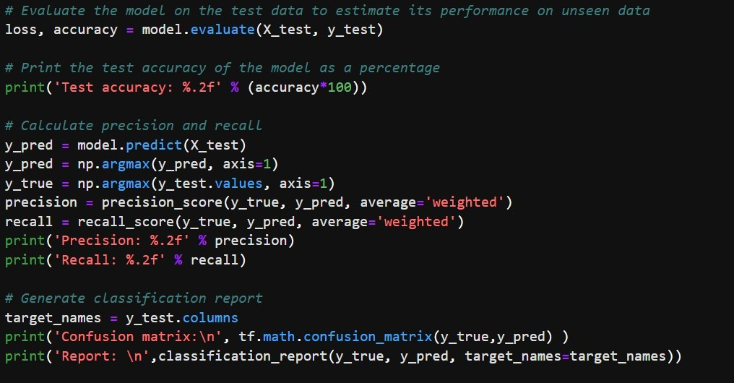

Slide 44
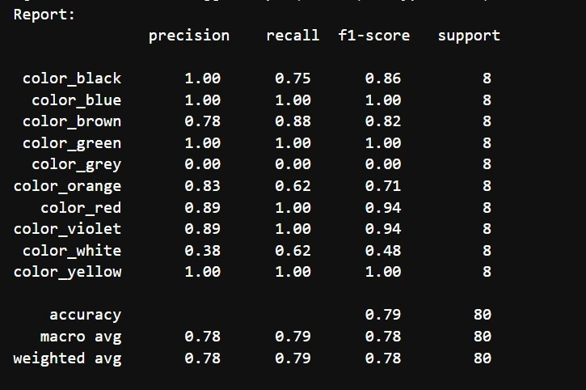
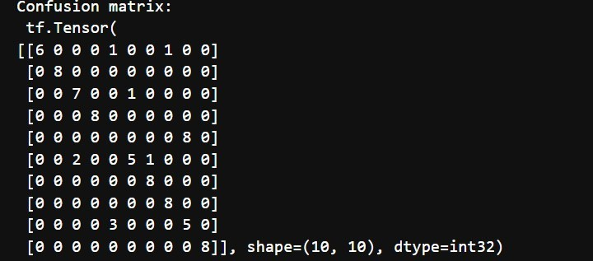

Slide 45
LOGISTIC REGRESSION MODEL
WE FIRST TRAIN A LOGISTIC REGRESSION MODEL ON THE DATA USING SCIKIT- LEARN' S LOGISTICREGRESSION CLASS.
WE FIT THE MODEL ON THE RGB VALUES OF THE IMAGES AND EVALUATE ITS
PERFORMANCE ON THE TEST SET USING ACCURACY, PRECISION, RECALL, AND A CLASSIFICATION REPORT.
THE LOGISTIC REGRESSION MODEL ACHIEVES HIGH ACCURACY ON THE TEST
SET, ALTHOUGH ITS PRECISION AND RECALL SCORES VARY ACROSS DIFFERENT COLORS.

Slide 46
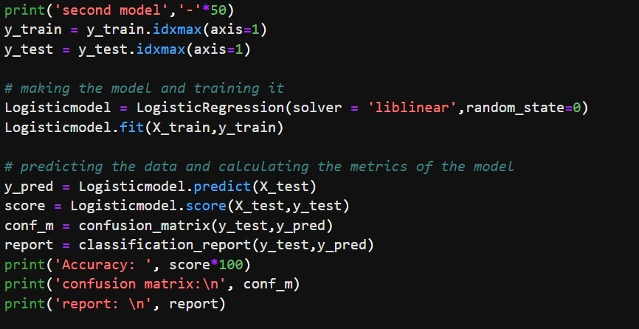

Slide 47
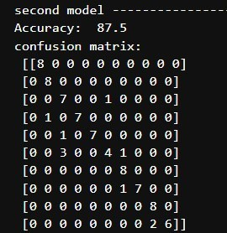
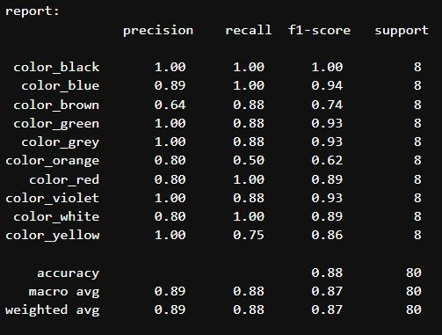

Slide 48
TESTING ON A NEW IMAGE
FINALLY, WE ALLOW THE USER TO TEST THE MODELS ON AN IMAGE OF THEIR CHOICE.
THE USER CAN INPUT THE PATH OF THE IMAGE TO TEST, AND THE SCRIPT WILL PREDICT THE COLOR LABEL USING BOTH THE LOGISTIC REGRESSION AND NN
MODELS.

Slide 49
TEST RUNS

Slide 50



Slide 51



Slide 52
Conclusion
WE EXPLORED TWO MACHINE LEARNING APPROACHES TO COLOR CLASSIFICATION:
LOGISTIC REGRESSION AND ARTIFICIAL NEURAL NETWORKS.
WE TRAINED AND EVALUATED THE MODELS ON A
DATASET OF IMAGES AND THEIR DOMINANT COLORS USING SCIKIT- LEARN AND KERAS LIBRARIES.
THE ANN MODEL OUTPERFORMED THE LOGISTIC
REGRESSION MODEL IN TERMS OF ACCURACY, PRECISION, AND RECALL ON THE TEST SET. THE SCRIPT ALSO ALLOWS THE USER TO TEST THE MODELS ON A NEW IMAGE,
DEMONSTRATING THE PRACTICAL APPLICATIONS OF COLOR CLASSIFICATION IN COMPUTER VISION.

Slide 53
THANK YOU

